Slide 1
Show Honor

Slide 2
Those who value the aged value the future

Slide 3
Ephesians 6:2-3 (NIV)
² “Honor your father and mother”—which is the first commandment with a promise— ³ “so that it may go well with you and that you may enjoy long life on the earth.”

Slide 4
Honor : Timao To Value or to Set a price

Slide 5
The “timao” of an iphone
Set the price
The “Timao” of a movie ticket
The “Timao” of Your Parents

Slide 7
Proverbs 20:29
The glory of young men is their strength, gray hair the splendor of the old.
Proverbs 16:21
Gray hair is a crown of splendor; it is attained in the way of righteousness.

Slide 8
Those who value the aged value the future

Slide 9
Ephesians 6:4
Fathers, do not exasperate your children; instead, bring them up in the training and instruction of the Lord.

Slide 10
Exasperate : parogizo provoke to anger

Slide 11
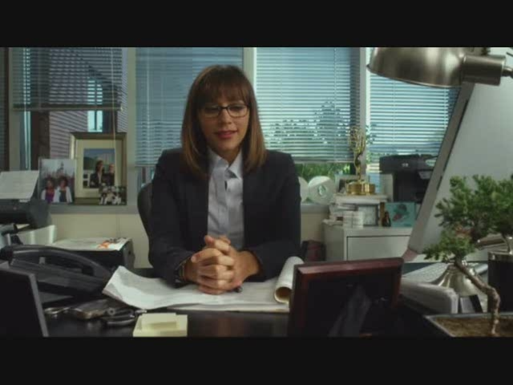

Slide 12
Showing honor should not be equal

Slide 13
Romans 12:10 (HCSB)
Show family affection to one another with brotherly love. Outdo one another in showing honor.

Slide 14
Matthew 27:9 (niv)
Thirty pieces of silver [was] the price set on him by the people of Israel.

Slide 15
Show Honor

